Slide 1
Unit-10 Graph
CompileD bY:
Ghanashyam BK

Slide 2
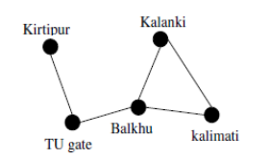
Introduction
A Graph is a non-linear data structure consisting of vertices and edges.
The vertices are sometimes also referred to as nodes and
the edges are lines or arcs that connect any two nodes in the graph.
More precisely, a graph is a data structure (V, E) that consists of
A collection of vertices V
A collection of edges E, represented as ordered pairs of vertices (u,v)
Many natural problems can be explained using graph for example modeling road network, electronic circuits, etc.
The example below shows the road network.

Slide 3
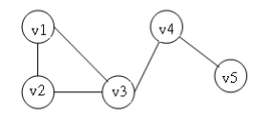
Introduction
Let us take a graph:
V(G)={v1, v2, v3, v4, v5}
E(G)={(v1,v2),(v2,v3),(v1,v3),(v3,v4),(v4,v5)}

Slide 4
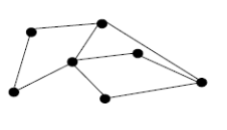
Types of Graph
Simple Graph:
We define a simple graph as 2 – tuple consists of a nonempty set of vertices V and a set of unordered pairs of distinct elements of vertices called edges.
We can represent graph as G = (V, E).
This kind of graph has no loops and can be used for modeling networks that do not have connection to themselves but have both ways connection when two vertices are connected but no two vertices have more than one connection.
The figure below is an example of simple graph

Slide 5
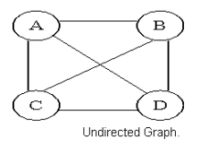
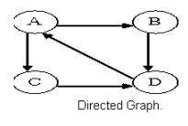
Types of Graph
Undirected Graph
A graph with only undirected edges is said to be undirected graph.
Directed Graph
A graph with only directed edges is said to be directed graph.

Slide 6
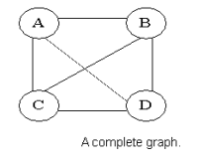
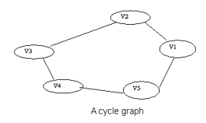
Types of Graph
Complete Graph
A graph in which any V node is adjacent to all other nodes present in the graph is known as a complete graph
Cycle Graph
A graph having cycle is called cycle graph. In this case the first and last nodes are the same. A closed simple path is a cycle.

Slide 7
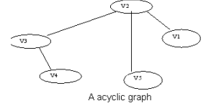
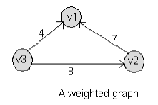
Types of Graph
Acyclic Graph
A graph without cycle is called acyclic graphs.
Weighted Graph
A graph is said to be weighted if there are some non negative value assigned to each edges of the graph. The value is equal to the length between two vertices. Weighted graph is also called a network.

Slide 8
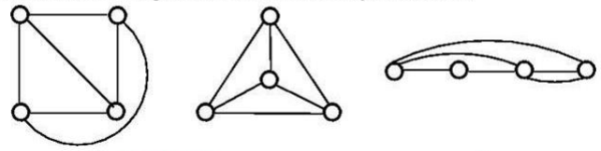
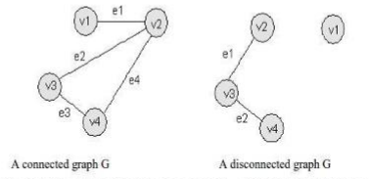
Types of Graph
Planar Graph
A graph that we can draw in a plane in such a way that no two edges of it cross each other except at a vertex to which they are incident.
Connected Graph
A graph G is said to be connected if there is atleast one path between every pair of vertices in G. Otherwise, G is disconnected.

Slide 9
Graph Terminologies
Two vertices u, v are adjacent vertices of a graph if {u, v} is an edge. The edge e is called incident with the vertices u and v if e = {u, v}.
This edge is also said to connect u and v. where u and v are end points of the edge.
Edges are three types:
Undirected Edge
Directed Edge
Weighted Edge
Degree of a vertex in an undirected graph is the number of edges incident with it, except a loop at a vertex.
Loop in a vertex counts twice to the degree.
Degree of a vertex v is denoted by deg (v).
A vertex of degree zero is called isolated vertex and a vertex with degree one is called pendant vertex.

Slide 10
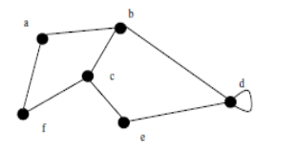
Example:
Find the degrees of the vertices in the following graph
Solution: deg(a) = deg(f) = deg(e) = 2 ; deg(b) = deg(c) = 3; deg(d) = 4

Slide 11
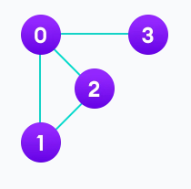
Graph Terminologies
Adjacency:
A vertex is said to be adjacent to another vertex if there is an edge connecting them. Vertices 2 and 3 are not adjacent because there is no edge between them.
Path:
A sequence of edges that allows you to go from vertex A to vertex B is called a path. 0-1, 1-2 and 0-2 are paths from vertex 0 to vertex 2.
Directed Graph:
A graph in which an edge (u,v) doesn't necessarily mean that there is an edge (v, u) as well. The edges in such a graph are represented by arrows to show the direction of the edge.

Slide 12
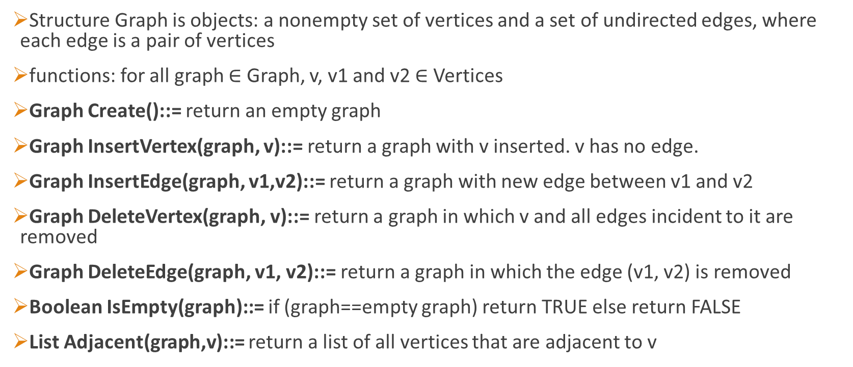
Graph as an ADT
Structure Graph is objects: a nonempty set of vertices and a set of undirected edges, where each edge is a pair of vertices
functions: for all graph $∈$ Graph, v, v1 and v2 $∈$ Vertices
Graph Create()::= return an empty graph
Graph InsertVertex(graph, v)::= return a graph with v inserted. v has no edge.
Graph InsertEdge(graph, v1,v2)::= return a graph with new edge between v1 and v2
Graph DeleteVertex(graph, v)::= return a graph in which v and all edges incident to it are removed
Graph DeleteEdge(graph, v1, v2)::= return a graph in which the edge (v1, v2) is removed
Boolean IsEmpty(graph)::= if (graph==empty graph) return TRUE else return FALSE
List Adjacent(graph,v)::= return a list of all vertices that are adjacent to v

Slide 13
Applications of graph theory
Electrical/Electronics - To design circuits
Control Engineering - In signal flow graphs
Computer science - It is used for algorithms
Dijkstra's Algorithm
Prism's Algorithm
Kruskal's Algorithm
Computer Network - To show interconnection of computers in the network.

Slide 14
Representation of a Graph
In graph theory, a graph representation is a technique to store graph into the memory of computer.
To represent a graph, we just need the set of vertices, and for each vertex the neighbors of the vertex (vertices which is directly connected to it by an edge).
If it is a weighted graph, then the weight will be associated with each edge.
There are different ways to optimally represent a graph, depending on the density of its edges, type of operations to be performed and ease of use.
Adjacency Matrix
Incidence matrix
Adjacency List

Slide 15
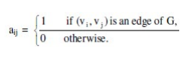
Representation of a Graph
Adjacency Matrix
Adjacency matrix is a sequential representation.
It is used to represent which nodes are adjacent to each other. i.e. is there any edge connecting nodes to a graph.
In this representation, we have to construct a n X n matrix A.
If there is any edge from a vertex i to vertex j, then the corresponding element of A, ai,j=1, otherwise ai,j=0
If there is any weighted graph then instead of 1s and Os, we can store the weight of the edge

Slide 16
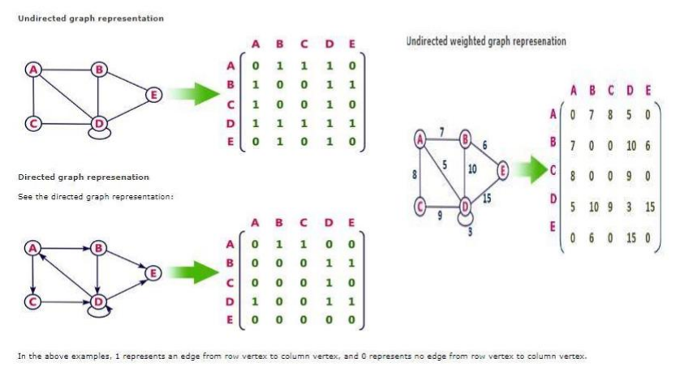
Representation of a Graph
Adjacency Matrix

Slide 17
Representation of a Graph
Incidence matrix
In Incidence matrix representation, graph can be represented using a matrix of size:
Total number of vertices by total number of edges.
It means if a graph has 4 vertices and 6 edges, then it can be represented using a matrix of 4X6 class. In this matrix, columns represent edges and rows represent vertices.
This matrix is filled with either 0 or 1 or -1. Where,
0 is used to represent row edge which is not connected to column vertex.
1 is used to represent row edge which is connected as outgoing edge to column vertex.
-1 is used to represent row edge which is connected as incoming edge to column vertex

Slide 18
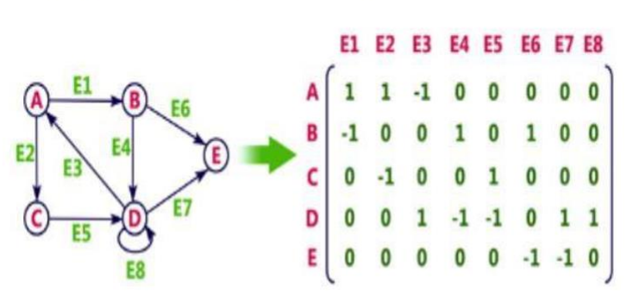
Representation of a Graph
Incidence matrix

Slide 19
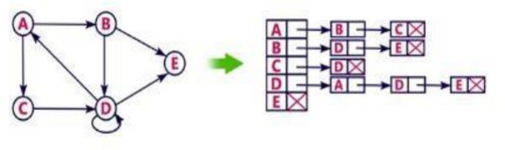
Representation of a Graph
Adjacency List
Adjacency list is a linked representation.
In this representation, for each vertex in the graph, we maintain the list of its neighbors. It means, every vertex of the graph contains list of its adjacent vertices.
We have an array of vertices which is indexed by the vertex number and for each vertex v, the corresponding array element points to a singly linked list of neighbors of v.
Let's see the following directed graph representation implemented using linked list:

Slide 20
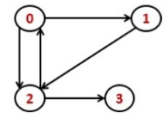
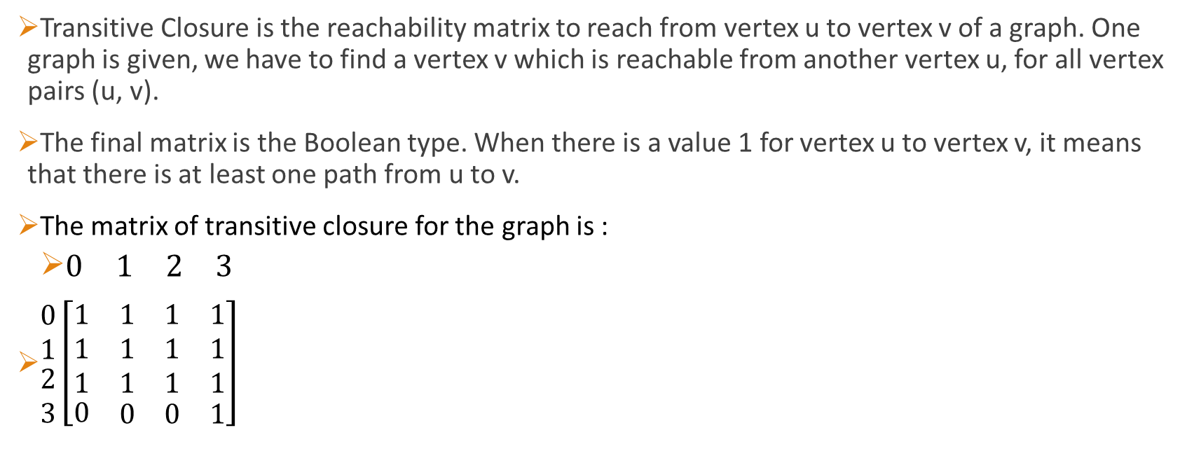
Transitive Closure property of graph
Transitive Closure is the reachability matrix to reach from vertex u to vertex v of a graph. One graph is given, we have to find a vertex v which is reachable from another vertex u, for all vertex pairs (u, v).
The final matrix is the Boolean type. When there is a value 1 for vertex u to vertex v, it means that there is at least one path from u to v.
The matrix of transitive closure for the graph is :
$\begin{matrix}\begin{matrix}0 & 1\end{matrix} & \begin{matrix}2 & 3\end{matrix}\end{matrix}$
$\begin{matrix}\begin{matrix}0 \\ 1\end{matrix} \\ 2 \\ 3\end{matrix}\left[\begin{matrix}\begin{matrix}1 \\ 1 \\ 1\end{matrix} & \begin{matrix}1 & 1 & 1 \\ 1 & 1 & 1 \\ 1 & 1 & 1\end{matrix} \\ 0 & \begin{matrix}0 & 0 & 1\end{matrix}\end{matrix}\right]$

Slide 21
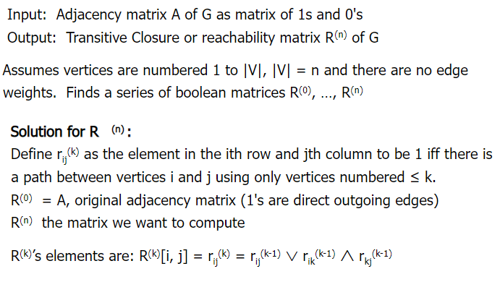
Warshall's Algorithm

Slide 22
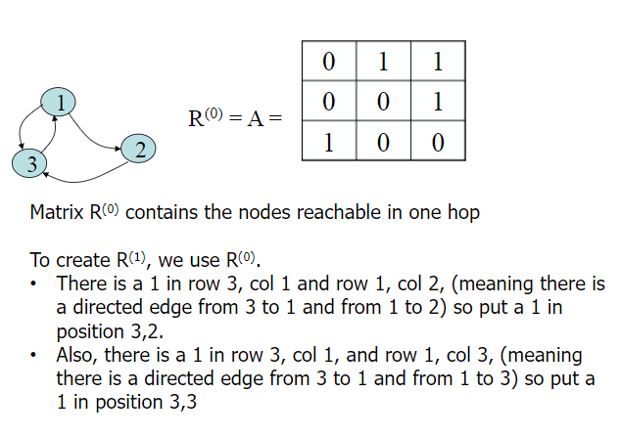
Warshall's Algorithm

Slide 23
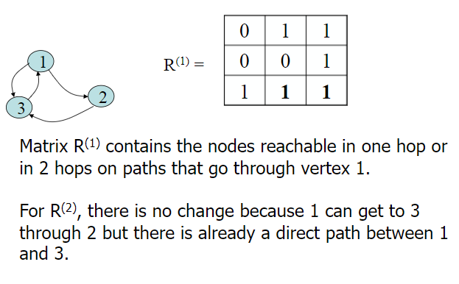
Warshall's Algorithm

Slide 24
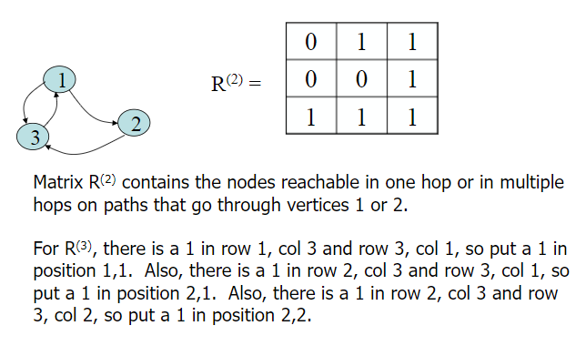
Warshall's Algorithm

Slide 25
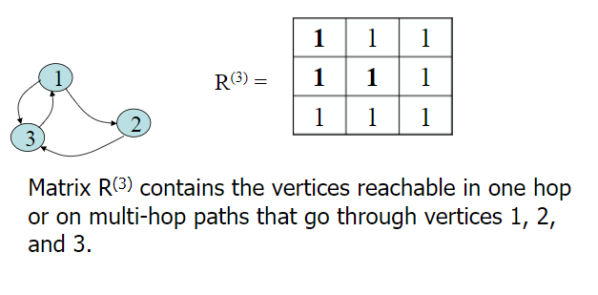
Warshall's Algorithm

Slide 26
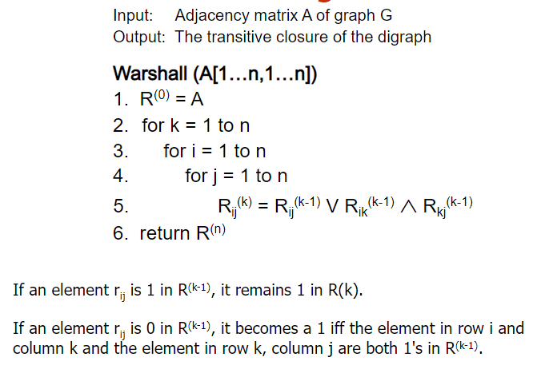
Warshall's Algorithm

Slide 27
Graph Traversal
Graph traversal is a technique used to search for a vertex in a graph.
It is also used to decide the order of vertices to be visited in the search process.
A graph traversal finds the edges to be used in the search process without creating loops.
This means that, with graph traversal, we can visit all the vertices of the graph without getting into a looping path.
There are two graph traversal techniques:
DFS (depth first search)
BFS (breadth first search)

Slide 28
Depth First Search
DFS traversal of a graph produces a spanning tree as final result.
Spanning Tree is a graph without loops.
We use Stack data structure with maximum size of total number of vertices in the graph to implement.
We use the following steps to implement DFS traversal
1. Define a stack of size total number of vertices in the graph.
2. Select any vertex as starting point for traversal. Visit that vertex and push it on to the Stack.
3. Visit any one of the non-visited adjacent vertices of a vertex which is at the top of stack and push it on to the stack.
4. Repeat step 3 until there is no new vertex to be visited from the vertex which is at the top of the stack.
5. When there is no new vertex to visit then use back tracking and pop one vertex from the stack.
6. Repeat steps 3, 4 and 5 until stack becomes Empty.
7. When stack becomes Empty, then produce final spanning tree by removing unused edges from the graph

Slide 29
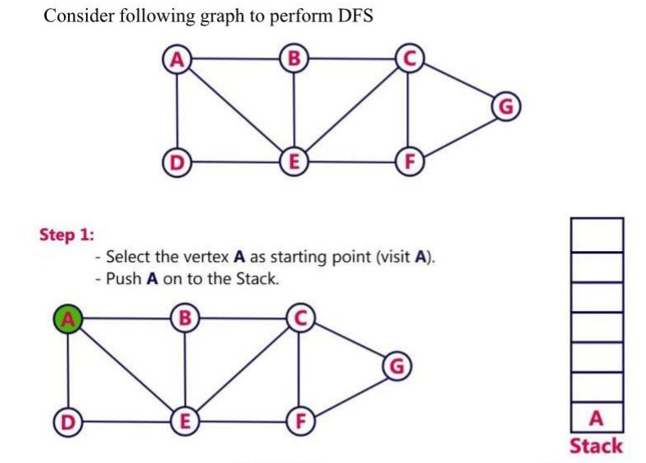
Depth First Search

Slide 30
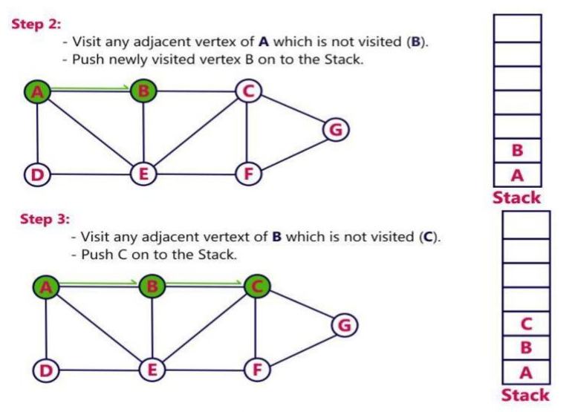
Depth First Search

Slide 31
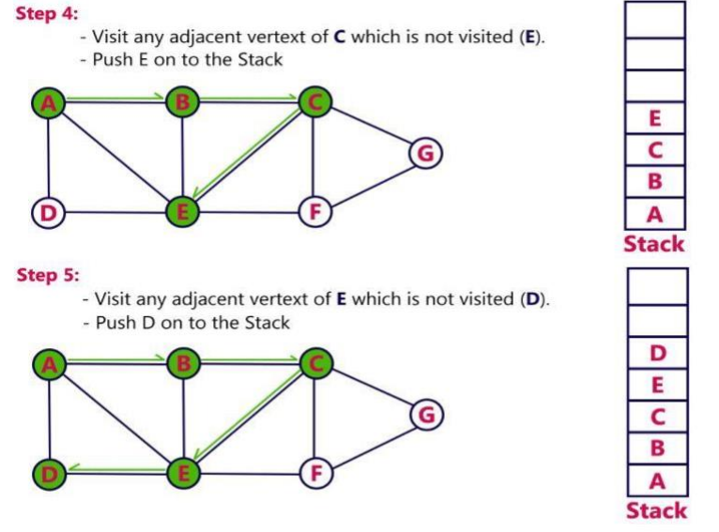
Depth First Search

Slide 32
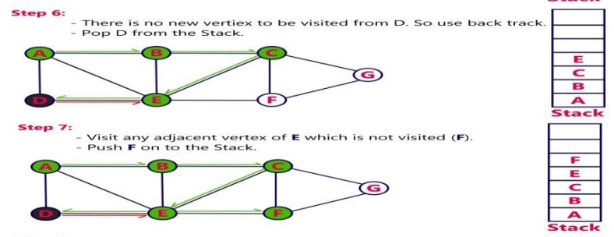
Depth First Search

Slide 33
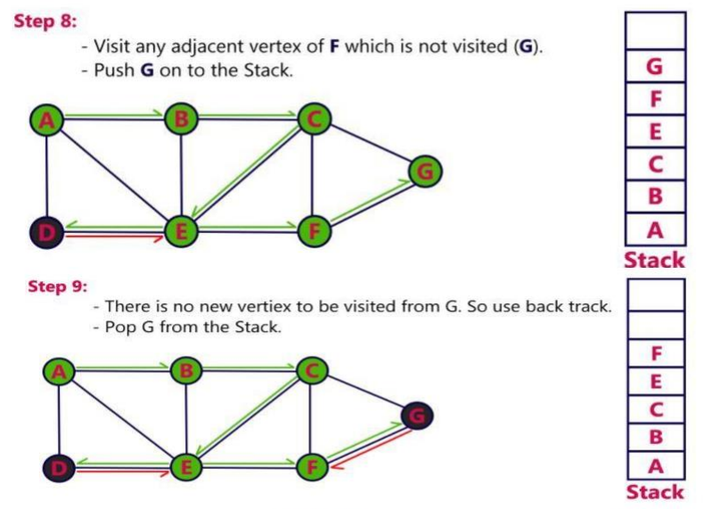
Depth First Search

Slide 34
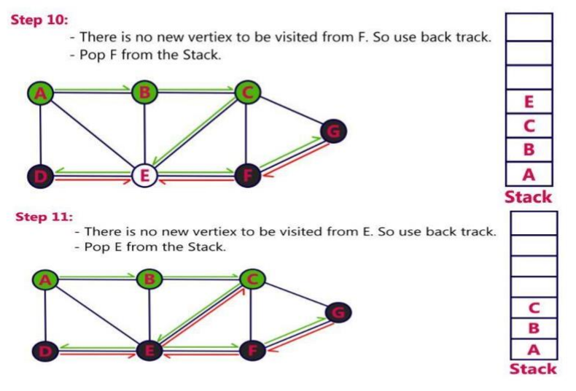
Depth First Search

Slide 35
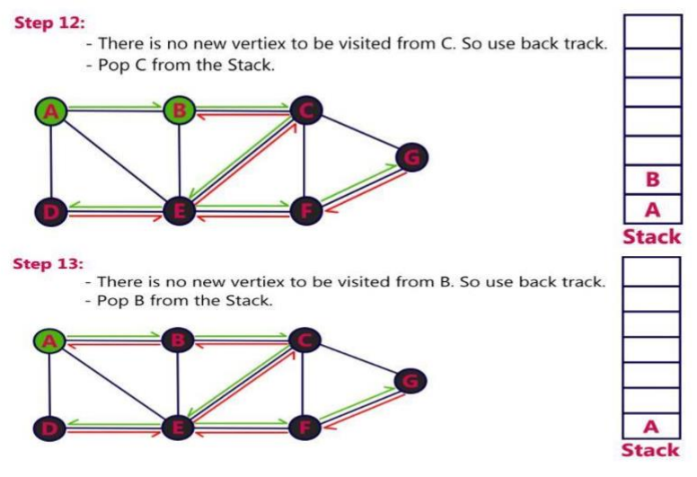
Depth First Search

Slide 36
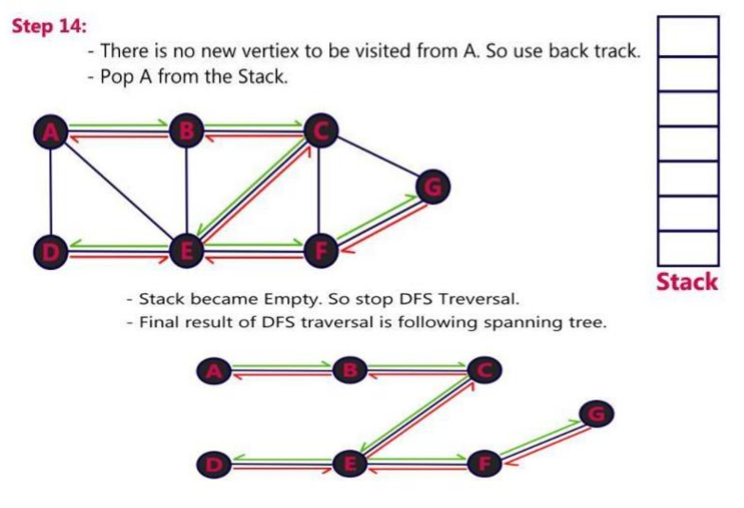
Depth First Search

Slide 37
Analysis of DFS
If G is represented by its adjacency matrix then the time to determine all vertices adjacent to v is O(n).
Since at most n vertices are visited the total time is O(n²).

Slide 38
Breadth First Search
BFS traversal of a graph produces a spanning tree as final result.
Spanning tree is a graph without loops.
We use Queue data structure with maximum size of total number of vertices in the graph to implement BFS traversal.
We use the following steps to implement BFS traversal
1. Define a Queue of size total number of vertices in the graph.
2. Select any vertex as starting point for traversal. Visit that vertex and insert it into the Queue.
3. Visit all the non-visited adjacent vertices of the vertex which is at front of the Queue and insert them into the Queue.
4. When there is no new vertex to be visited from the vertex which is at front of the Queue then delete that vertex.
5. Repeat steps 3 and 4 until queue becomes empty.
When queue becomes empty, then produce final spanning tree by removing unused edges from the graph

Slide 39
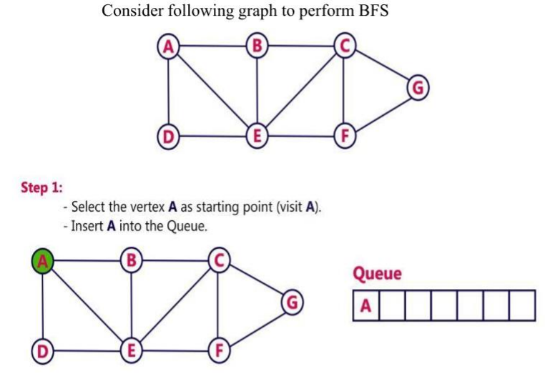
Breadth First Search

Slide 40
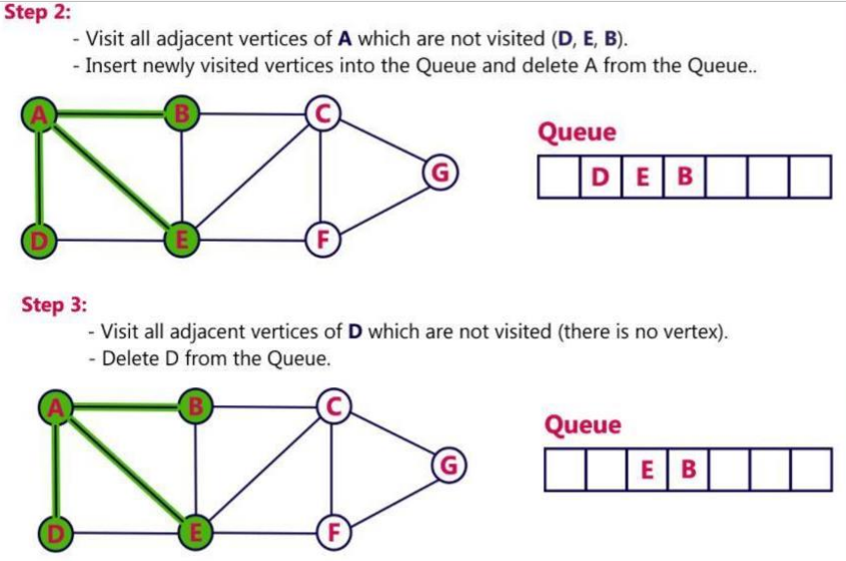
Breadth First Search

Slide 41
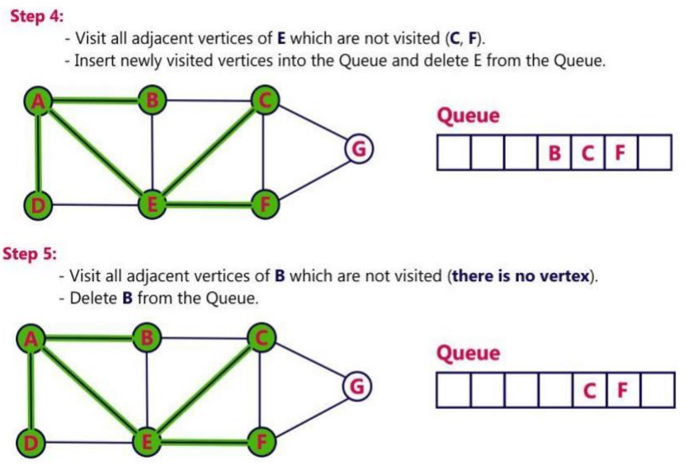
Breadth First Search

Slide 42
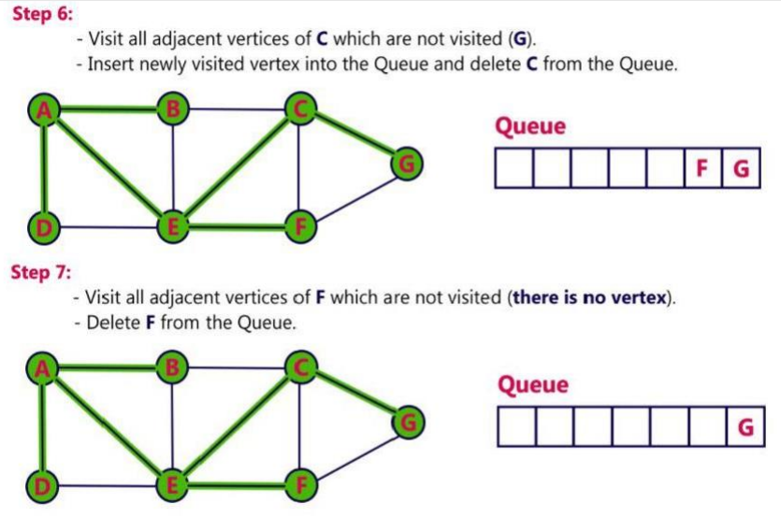
Breadth First Search

Slide 43
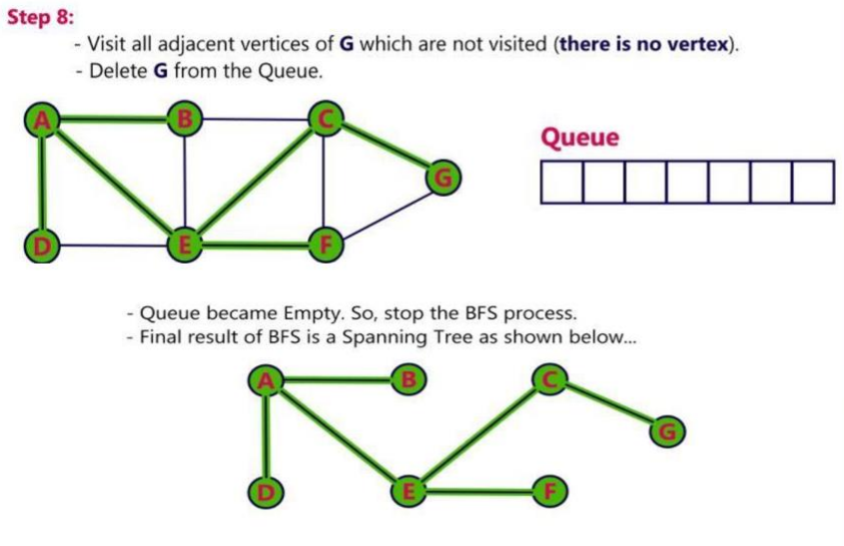
Breadth First Search

Slide 44
Analysis of BFS
Each visited vertex enters the queue exactly once.
So the while loop is iterated at most n times
If an adjacency matrix is used the loop takes O(n) time for each vertex visited.
The total time is therefore, O(n2 ).

Slide 45
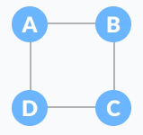
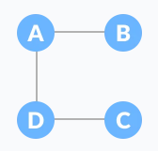
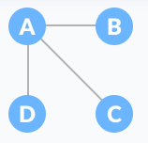
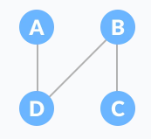
Spanning Tree
spanning tree is a sub-graph of an undirected connected graph, which includes all the vertices of the graph with a minimum possible number of edges.
If a vertex is missed, then it is not a spanning tree.
The edges may or may not have weights assigned to them.
Normal Graph
Spanning Tree
Spanning Tree
Spanning Tree

Slide 46
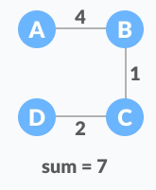
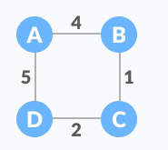
Minimum Spanning Tree
A minimum spanning tree is a spanning tree in which the sum of the weight of the edges is as minimum as possible.
Weighted Graph
Minimum Spanning Tree

Slide 47
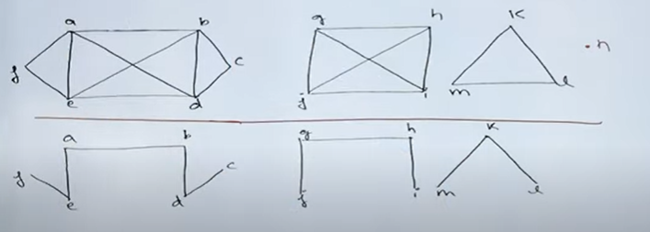
Spanning Forest
if a graph is not connected, then there is no possibility of finding a spanning tree, but we can find a spanning forest.
If a graph is not connected then we can find connected components, finding a spanning tree in each component we can find spanning forest.
A disconnected graph with K components has a spanning forest consisting of K spanning tree
Graph with vertex (a,b,c,….n)
Spanning forest of the graph

Slide 48
Kruskal's Algorithm
Kruskal's algorithm is a minimum spanning tree algorithm that takes a graph as input and finds the subset of the edges of that graph which
form a tree that includes every vertex
has the minimum sum of weights among all the trees that can be formed from the graph
It falls under a class of algorithms called greedy algorithms that find the local optimum in the hopes of finding a global optimum.

Slide 49
Working of Kruskal's Algorithm
We start from the edges with the lowest weight and keep adding edges until we reach our goal.
The steps for implementing Kruskal's algorithm are as follows:
Sort all the edges from low weight to high
Take the edge with the lowest weight and add it to the spanning tree. If adding the edge created a cycle, then reject this edge.
Keep adding edges until we reach all vertices.

Slide 50
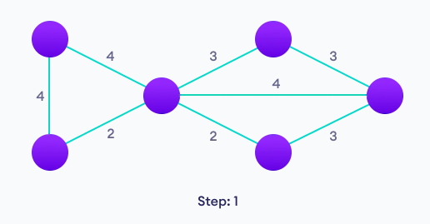
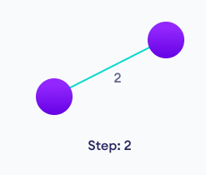
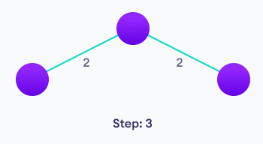
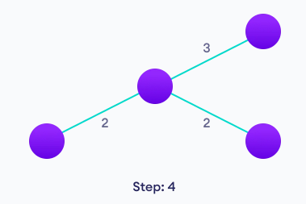
Example of Kruskal's Algorithm
Start with a weighted graph
Choose the edge with the least weight,
if there are more than 1,choose anyone
Choose the next shortest edge and add it
Choose the next shortest edge that
doesn't create a cycle and add it

Slide 51


Example of Kruskal's Algorithm
Choose the next shortest edge that
create a cycle and add it
Repeat until you have a spanning tree

Slide 52
Prim's Algorithm
Prim's algorithm is a minimum spanning tree algorithm that takes a graph as input and finds the subset of the edges of that graph which
form a tree that includes every vertex
has the minimum sum of weights among all the trees that can be formed from the graph
It falls under a class of algorithms called greedy algorithms that find the local optimum in the hopes of finding a global optimum.

Slide 53
Working of Prim's Algorithm
We start from one vertex and keep adding edges with the lowest weight until we reach our goal.
The steps for implementing Prim's algorithm are as follows:
Initialize the minimum spanning tree with a vertex chosen at random.
Find all the edges that connect the tree to new vertices, find the minimum and add it to the tree
Keep repeating step 2 until we get a minimum spanning tree

Slide 54





Example of Prim's Algorithm
Choose a vertex
Choose the shortest edge from
this vertex and add it
Start with a weighted graph
Choose the nearest vertex
not yet in the solution
Choose the nearest edge not yet in the solution,
if there are multiple choices, choose one at random

Slide 55

Example of Prim's Algorithm
Repeat until you have a spanning tree

Slide 56
Round Robin Algorithm
It builds a collection of blue trees, by repeatedly merging trees using the following rule, until there is just one tree left.
Coloring Rule. Select a blue tree and minimum cost edge incident to it. Color the edge blue
An edge is incident to a tree if one of its endpoints is in the tree and the other is not.
Algorithm
Initialize: F: a forest consisting of isolated vertices of G.
Terminate: If F is a tree then terminate.
Update: Select any tree T in F (cut selection). Add to F a minimum cost edge between T and another tree in F (edge selection). Go to the Termination.

Slide 57

Minimum Spanning Tree
Construct a minimum spanning tree using Kruskal's Algorithm and Prim’s Algorithm

Slide 58
Greedy Algorithm
A greedy algorithm is an approach for solving a problem by selecting the best option available at the moment.
It doesn't worry whether the current best result will bring the overall optimal result.
The algorithm never reverses the earlier decision even if the choice is wrong.
It works in a top-down approach.
This algorithm may not produce the best result for all the problems.
It's because it always goes for the local best choice to produce the global best result.

Slide 59
Greedy Algorithm
Advantages
The algorithm is easier to describe.
The algorithm can perform better than other algorithms (but, not in all cases).
Disadvantages
the greedy algorithm doesn't always produce the optimal solution. This is the major disadvantage of the algorithm.

Slide 60
Shortest Path Problem
In graph theory, the shortest path problem is the problem of finding a path between two vertices (or nodes) in a graph such that the sum of the weights of its constituent edges is minimized.
The problem of finding the shortest path between two intersections on a road map may be modeled as a special case of the shortest path problem in graphs,
where the vertices correspond to intersections and
the edges correspond to road segments, each weighted by the length of the segment.

Slide 61

Dijkstrs's Algorithm
Dijkstra's algorithm allows us to find the shortest path between any two vertices of a graph.
It differs from the minimum spanning tree because the shortest distance between two vertices might not include all the vertices of the graph.
It is a greedy algorithm that solves the single-source shortest path problem for a directed graph G = (V,E) with non-negative edge weights, i.e., w (u, v) > 0 for each edge (u, v) $∈$E.
Dijkstra's Algorithm maintains a set S of vertices whose final shortest path weights from the source s have already been determined. That's for all vertices v E S; we have d [v] = $δ$ (s, v).
The algorithm repeatedly selects the vertex u $∈$ V - S with the minimum shortest - path estimate, insert u into S and relaxes all edges leaving u.
Because it always chooses the "lightest" or "closest" vertex in V-S to insert into set S, it is called as the greedy strategy

Slide 62
Dijkstrs's Algorithm
1. The very first step is to mark all nodes as unvisited,
2. Mark the picked starting node with a current distance of 0 and the rest nodes with infinity,
3. Now, fix the starting node as the current node,
4. For the current node, analyze all of its unvisited neighbors and measure their distances by adding the current distance of the current node to the weight of the edge that connects the neighbor node and current node,
5. Compare the recently measured distance with the current distance assigned to the neighboring node and make it as the new current distance of the neighboring node,
6. After that, consider all of the unvisited neighbors of the current node, mark the current node as visited,
7. If the destination node has been marked visited then stop, an algorithm has ended, and
8. Else, choose the unvisited node that is marked with the least distance, fix it as the new current node, and repeat the process again from step 4.

Slide 63

Dijkstrs's Algorithm (Example)

Slide 64

Dijkstrs's Algorithm (Example)

